Slide 1
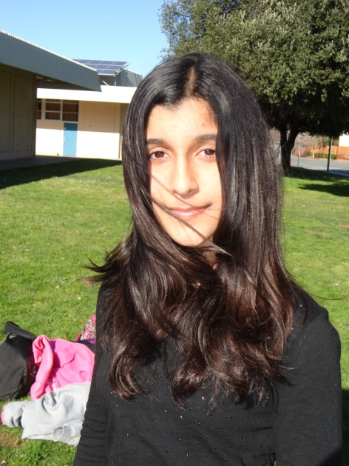
IcyOcean News Show! Episode 1
Reporter: Rojeen
Special Thanks:
Michaela Kearton

