Slide 1

Ice Cream!
Click on the shapes on the
left side to go to a
hyperlink, or you can just
click on the slides.
By:Nikka
Click here!

Slide 2

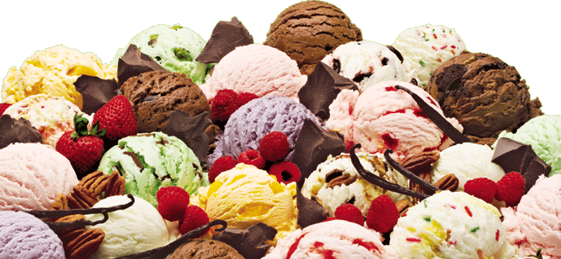
Flavors!
click
Cappuccino
Mint chip
Vanilla
Cookies n Cream
Strawberry
Coffee
Chocolate

Slide 3
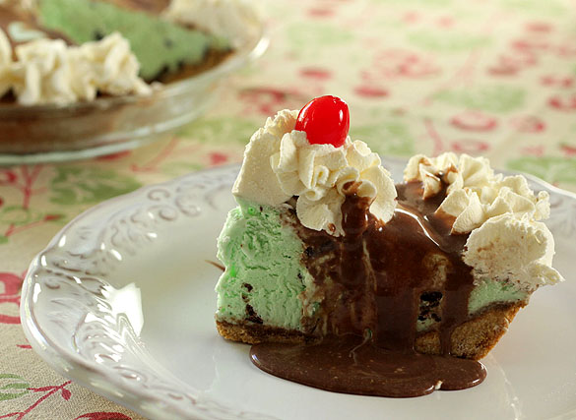
Toppings with Mint chip
Click!
-Chocolate syrup
-Brownie pieces
-Chocolate chips
-Cookie dough

Slide 4
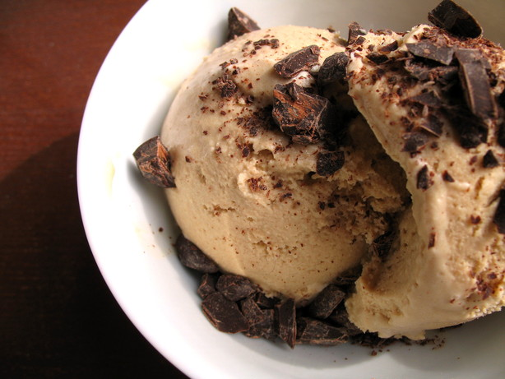
Toppings with cappuccino
Cookie dough
Chocolate syrup
Mix it with coffee
click

Slide 5
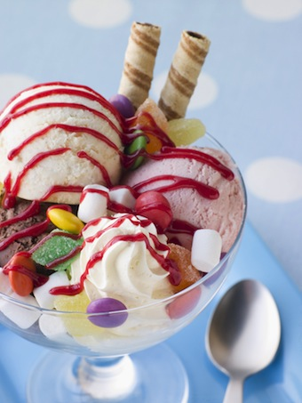
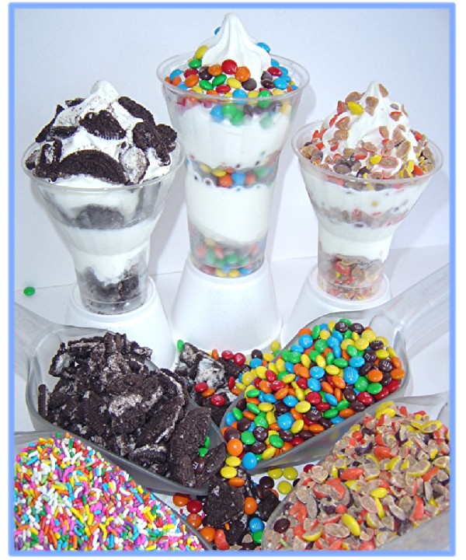
Toppings with Vanilla
Chocolate syrup
Gummy worms
M&M
Skittles
Cookie dough
Oreo pieces
click
Yummm!

Slide 6
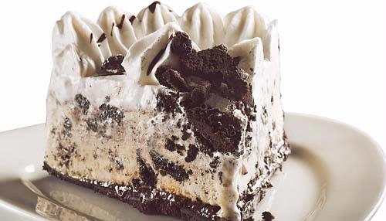

Cookies and cream toppings
click
Cookies
Oreo pieces
Cookie dough
Whipped cream

Slide 7

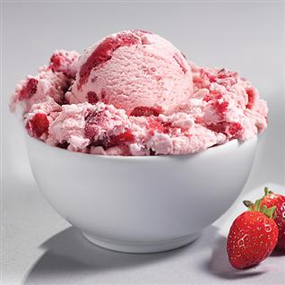
Toppings with Strawberry!
click
Strawberry seeds
Strawberry

Slide 8
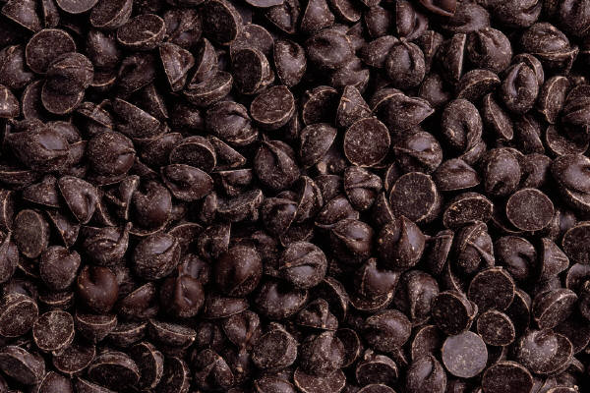
Toppings with Coffee!
click
Chocolate!!!!
Chocolate chips!!!

Slide 9
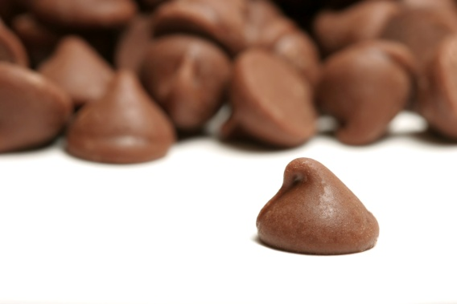
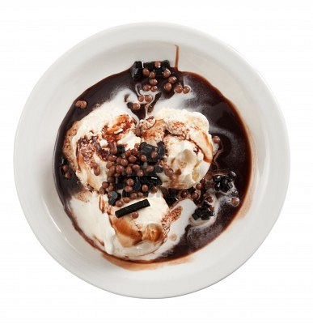
Toppings with Chocolate!!
click!
Chocolate syrup
Hershey kiss
Chocolate chips

Slide 10
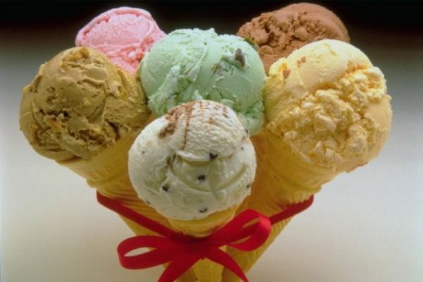

Thank you for watching!

